Slide 1

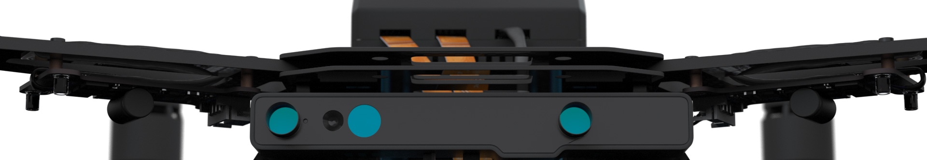
Autonomous Drone Engineer B3 – 3D and Visual Sensors
Paul.Guermonprez@intel.com Autonomous Drone Solutions Architect

Slide 2
The Perfect 3D Sensor

Slide 3
Sensor Goals
A drone can do a lot with an Inertial Motion Unit, a compass and a GPS.
To be autonomous and perform useful tasks, you may also need to:
Measure the distance with a known surface Ex: sonar to measure the distance with the ground (height)
Detect objects (but not map them) to avoid collisions
Scan and map the environment in 3D. Ex: LIDAR to map the ground
Reposition the drone inside a know volume, or compared to a surface
Each sensor has a specific goal Drones usually carry multiple sensors to solve different problems

Slide 4
Collision Avoidance vs Autonomy vs Payload
Different goals:
Collision avoidance in exceptional cases. Ex: Typhoon-H
Payload scanning the environment for remote analysis. Ex: mining site 3D scan
Autonomous flight around objects, under human supervision
Full 3D awareness for autonomous flight in unknown environments
Speed - range: do you need assistance for take-off/landing or cruise?
Efficiency - risk: perfect / good enough ? Full mapping or simple repositioning in a known map?
There is not a single 3D solution for all needs

Slide 5
Fusion of sensors
There is no perfect sensor!
Select the right mix for your case
Reuse sensor and libraries from other sectors: automobile, robotics, …
Know their blind spots
Play to their strengths
Work on sensor fusion

Slide 6
Types of Positioning

Slide 7
Outdoor – D-GPS Differential GPS (or “RTK”)
Simple GPS receiver are not very precise: 1.5-3m.
Most drones can benefit from Differential GPS:
Use an improved GPS chip, designed for D-GPS (200$)
Integrate precisely the GPS antenna to the chip
Add a fixed base in a 20km radius with the same chip
Add a radio/IP link to your drone
Result:
The base station will communicate with your drone
The drone will use the D-GPS chip to normalize the signal
You’ll get a position with 2-3cm precision

Slide 8
Indoor – UWB UltraWideBand
It’s a time-of-flight system, not a signal strength system (like wifi/BT).
UWB wavelength allows for 10cm precision inside buildings as large as warehouses.
There’s 2 ways to deploy UWB:
Use a simple tag, and smart connected wall anchors will locate it.
Use a smart receiver, and it will locate itself knowing where the (non connected, non smart) anchors are in the building. That’s the one we want for large drones.

Slide 9
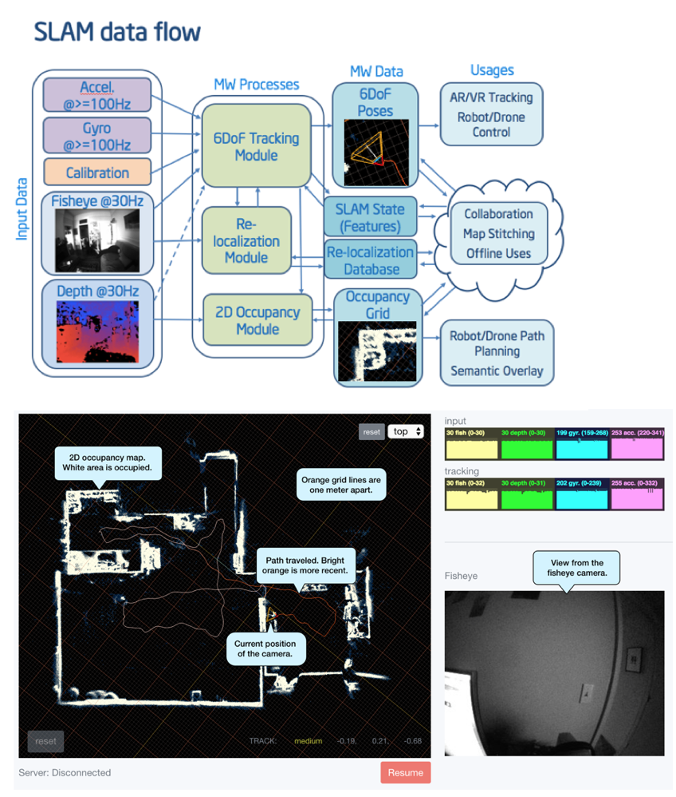
Indoor – SLAM Simultaneous Localization And Mapping
Why: If you need indoor localization but can’t deploy UWB anchors (because of cost, or unknown building)
Hardware: Use 3D sensors (like RealSense) or a moving camera (harder) + inertial sensors
Software: stack adapted to your sensors, performing a complex sensor fusion

Slide 10
Indoor - Visual
What if you can’t afford to deploy UWB, and SLAM is too complex?
Print and stick visual markers.
Libraries: VISP, ARToolkit
Robust, highly optimized code
Return 3D positioning
Also works with 3D models of objects instead of BCHs

Slide 11
Sensors

Slide 12
1D: measure distance (with the ground)
A sonar or 1D laser can measure the distance with the ground.
That’s required for your drone can hover at a precise height, and perform a smooth landing.
Note: A barometer can provide you the altitude, which is not precise enough to land.
Photos: MB1242 I2CXL-MaxSonar-EZ4 LIDAR-Lite v3
http://www.maxbotix.com/Ultrasonic_Sensors/MB1242.htm
https://buy.garmin.com/en-US/US/p/557294

Slide 13
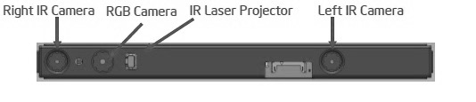
3D sensor
By using 2 cameras you can recreate a 3D image. Two options:
By running an intensive software on your CPU/GPU, but it takes space, increases the weight and it’s expensive.
Or by using a dedicated chip, bundled with the 2 cameras. It’s compact, cheap and light. Ex: Intel RealSense, with infrared grid illumination technology.
As a result, you get :
Format: directly a 3D depth map and RGB image
Depth: 4-5m for the Intel R200
Coverage: only shows what is on front of the sensor, Example: 120x60 degrees but can bundle 3 sensors to get 360x60 degrees of coverage
Photo: Intel R200 RealSense

Slide 14
3D reconstruction from a 2D sensor
Laser can go far and distance information is precise.
By rotating a laser, you get 1 dimension of depth information, 360. That’s a LIDAR.
By rotating over 2 axis, you can go a little further. Ex: 360x15 degrees.
By embedding the rotating on a drone and flying you can accumulate data and build a 3D model. Ex: mapping a construction site.
Photo: Velodyne PUCK™ LIDAR VLP-16
http://velodynelidar.com/vlp-16.html

Slide 15
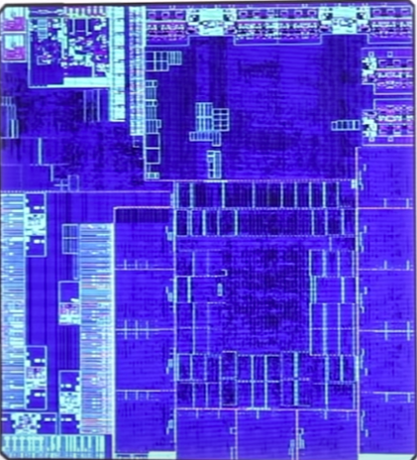
Computer Vision: Collision Avoidance
With 1 camera and a succession of shots taken while moving in 1 direction, you can reconstruct what’s in front of you in 3D.
Great if you’re moving fast, or want to see far ahead
Works great for simple collision avoidance
Cheaper, lighter than LIDARs
Ex: Intel Movidius chips
Photo: Intel Movidius Myriad 2 VPU in DJI Spark Drone
https://newsroom.intel.com/news/intel-movidius-myriad-2-vpu-enables-advanced-computer-vision-deep-learning-features-ultra-compact-dji-spark-drone/

Slide 16
Computer Vision: Structure from Motion
With 1 camera and a succession of shots taken while moving around an object, you can reconstruct this object in 3D.
Typically used as a payload to 3D scan the outside of a building
Usually done offline, with high-resolution photos and heavy computations to get the best model possible. But can be deployed in flight under certain conditions.
Ex: Pix4D, FPV Camera, Drone Deploy, …
Photo: Pix4D example
https://pix4d.com/a-new-era-for-landscaping-and-exterior-design/

Slide 17
Computer Vision: Visual Piloting
You can also use a camera to recognize objects, barcodes, patterns …
Ex: With 1 camera facing downward, you can recognize the ground and make the drone hover without driving: “Optical Flow”. It is typically linked to the flight controller itself.
Ex: With 1 camera or laser reader, you can read barcode. Can be useful in a warehouse inventory scenario.
Photo: PX4Flow
https://pixhawk.org/modules/px4flow

Slide 18
Computer Vision: Augmented Reality
With 1 camera and an advanced library, you can go further and detect where you are in 3D, how objects around you are moving.
Such libraries usually come from the Augmented Reality world, after adaptation to robotics.
Photo: Artoolkit, VISP
http://visp.inria.fr https://artoolkit.org/

Slide 19
Conclusion

Slide 20
Conclusion
There is no perfect sensor able to see everything
Each sensor has specific features
Be clear about your goals, regarding the flight stack and user payload
Your drone will use several sensors
You’ll have to fusion the data from several sensors

Slide 21
Thanks
Paul.Guermonprez@intel.com

